Slide 1
Business and Industrial Economics
Prof. Luca Grilli
Industrial (Innovation) Policy

Slide 2
Rationales for public sustainment to R&D activities
Private firms (may) invest less than the social optimum
2 reasons
(widely shared)
Knowledge Spillovers
Capital market imperfections

Slide 3
KNOWLEDGE SPILLOVERS
Initial idea dates back to Schumpeter (1946, ch. 8), then developed by Nelson (1959, JPE) and Arrow (1962 ch. In edited book) among the first:
“The primary output of R&D investments is the knowledge of how to make new goods and services, and this knowledge is not rival- use by one firm does not preclude its use by another. To the extent that knowledge cannot be kept secret, the returns to the investment in it cannot be appropriated by the firm undertaking the investment, and therefore such firms will be reluctant to invest, leading to the underprovision of R&D investments in the economy” (Hall 2002 OREP, p. 35).
The argument rely on the stylized facts that any formal and/or informal mechanism to protect innovation is only partly efficient at the very best.
The underprovision of R&D is more severe for high-tech start-ups due to the higher relative costs in protecting innovation (e.g. costs of patents too high, lack of complementary assets, see Teece 1986, Research Policy).

Slide 4
Critique to the Spillovers rationale
Existence of spillovers in research generally accepted, documented on an empirical ground (e.g. Griliches 1992, SJE), even if obvious measurement problems exist. Often “localized” (e.g. Adams and Jaffe 1996, RAND)
But does the mere existence of spillovers justify policy intervention?
Vision
Manna from heaven
Firm_{i}
R&D_{i}< R&D*_{i} limit spillovers towards Firms_{j}
No R&D cost
R&D_{i} π_{j}
Result: <
ΣR&D
ΣR&D*

Slide 5
Critique to the Spillovers rationale
R&D and “absorptive capacity” (Cohen and Levinthal 1989 EJ, 1990 ASQ)
Vision
No free lunch
Firm_{i}
R&D_{i}
π_{j}
R&D_{i} & R&D_{j}
Iff R&D_{j} no pure duplicative & imitative effort , i.e. R&D_{i} & R&D_{j} not overlapping in content
(see Klette et al. 2000, RP, pp. 487-488)
Open innovation paradigm reinforces this argument
Result: ?
ΣR&D
ΣR&D*

Slide 6
CAPITAL MARKET IMPERFECTIONS [see lecture on “Asymmetric Information: remarks on Finance for Innovation”]
Hidden info (adverse selection)
Asymmetric Information
Capital market imperfection
Hidden action (moral hazard)

Slide 7
Empirical evidence
Empirically analyses generally confirm greater financial constraints suffered from R&D investments than other typology of investment
(View by Fazzari, Hubbard and Petersen 1988, BPEA):
Cash Flow R&D (e.g. Hall 1992, NBER; Himmelberg and Petersen 1994, RES; Ughetto 2008, CJE).
(View by Kaplan and Zingales 1997, QJE; method):
Credit rating index R&D (e.g. Czarnitzki and Hottenrott 2011, SBE)
“Near universal recognition of the presence of market failure in the provision of finance for high-tech start-ups” (Storey and Tether 1998, RP, p. 1049). See also Revest and Sapio 2012, SBE for a recent survey.

Slide 8
Taxonomy
Policy Measures
Fiscal incentives to R&D
2. Grants to R&D
3. Innovative Entrepreneurship Policy
Broader than that [see Edler & Fagerberg, 2017, Innovation policy: what, why, and how, Oxford Review of Economic Policy, vol. 33 (1), p. 12] but these 3 lines figure as prominent interventions.

Slide 9

Policy intervention: 1-2
Public direct “hands-on” intervention for R&D
2 broad typologies of R&D subsidies
Grants (“selective”)
Fiscal incentive (“automatic”)
Worldwide implementation of these schemes at various levels (supra-national, federal/national, regional/local) in the past, present and probably in the future.

Slide 10
The “Crowding-in” or “Crowding-out” issue
Tons of literature on the crowding-in or crowding-out effects
1) Crowding-in (additionality): public R&D subsidies increase private R&D expenditure.
2) Neutral effect: public R&D subsidies do not stimulate neither depress private R&D expenditure. On one hand, public subsidy increase overall R&D budget of the firm so it is likely that R&D projects are undertaken that would have not materialize in the absence of the subsidy. On the other hand, subsidies have to be financed (with taxes) so benefits are uncertain.
3-4) (Full or partial) Crowding-out (substitution): public funding mere substitute private funding and there is no (or few) undertaking of new R&D project. Firms would have realized (many of) those projects even in the absence of the subsidy.

Slide 11
Grants vs. Tax credits (automatic fiscal incentives)
“To be successful, a program must target marginal projects or those that face some type of constraint. These are not so promising that they will be privately funded in the absence of the program, yet are not so poor quality that they will fail regardless of their financial support.” (Howell S. 2024).
Major cons
Selectivity
Possible errors and distortions (main among others):
Public may be less competent than private (unable to “Pick (future) Winners”)
Public may avoid risks: “Cherry Picking” (Lerner 1999, JB)
Major pros
Selectivity
Possible to send funds where most needed (from a social point of view)
No complications to the tax system (vs. fiscal incentives)
No room for recipient firms to re-label as R&D activities that are not (vs. fiscal i.)
But
Grants
Have another main “indirect” advantage

Slide 12



Indirect effects of grants (and prizes)
“Stamp of approval” (aka “halo” or “certification” effect, Lerner 1999, JB and 2002 EJ)
The “stamp of approval” effect proves to be important also for high-tech start-ups in the European context (e.g. Colombo et al. 2011 Economics Letters, 2013 Industrial and Corporate Change; Grilli and Murtinu, 2018, Research Policy).
Selective (grants) rather than automatic (fiscal incentives) proves to be beneficial
Policy
Signal

Slide 13
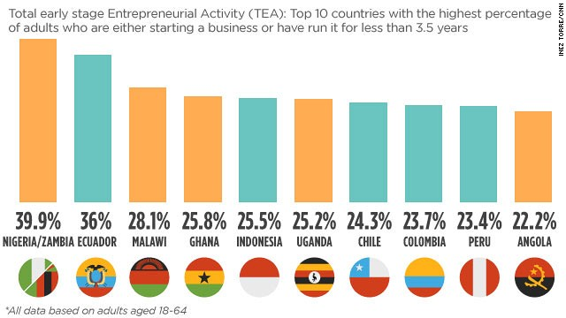
Policy intervention: 3 Important premise
Entrepreneurship policy
≠
Increase Entrepreneurship rate
Source: GEM annual report 2014

Slide 14
Shane (2009, SBE) & Santarelli and Vivarelli (2002, ICC)
Santarelli, E., & Vivarelli, M. (2002). Is subsidizing entry an optimal policy?. Industrial and Corporate Change, 11(1), 39-52.
2 risks: deadweight and substitution effects
“[…] If the selection process is the outcome of a Bayesian process of learning, a subsidy may be both useless (the more efficient entrepreneur does not need it, while the less efficient one leaves the market once the subsidy ceases to be in operation) and harmful (less efficient entrepreneurs are given an artificial seedbed, while market competition would have induced them to leave the market). If the former situation is prevalent, the industrial policy supporting entry is affected by a deadweight component; if the latter is prevalent a substitution effect arises”.
See also Scott Shane: “Why encouraging more people to become entrepreneurs is bad public policy” (Small Business Economics, 2009, vol 33, pp. 141-149).

Slide 15
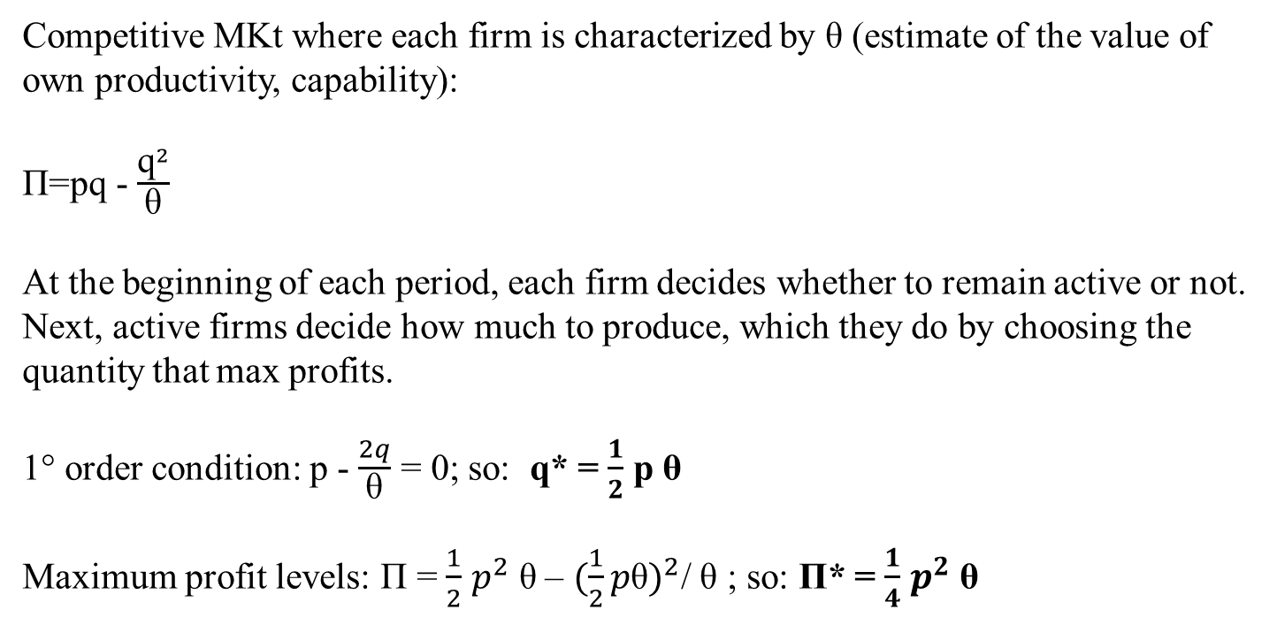
From Lecture 3
Competitive selection model
Jovanovich 1982, Econometrica
Competitive MKt where each firm is characterized by θ (estimate of the value of own productivity, capability):
Π=pq - $\frac{{\text{q}}^{2}}{\text{θ}}$
At the beginning of each period, each firm decides whether to remain active or not. Next, active firms decide how much to produce, which they do by choosing the quantity that max profits.
1° order condition: p - $\frac{2q}{\text{θ}}$ = 0; so: q* = $\frac{1}{2}$ p θ
Maximum profit levels: Π = $\frac{1}{2}$ $p^{2}$ $\text{θ}$– ${(\frac{1}{2}p\text{θ})}^{2}$/ θ ; so: Π* = $\frac{1}{4}$ $p^{2}$ $\text{θ}$

Slide 16

Policy intervention: 3
Several recent interventions (especially after the Great Financial Crisis) try to stimulate “innovative” entrepreneurship with the tendency to overarch all these measures under a unique coherent umbrella (as a proper industrial policy should do).
We have seen the blossom of Startup Acts around the world
See Audretsch et al., 2020 for a review in Research Policy, 2020, 49, article 104027
Startup America
• Gründerland Deutschland
• Startup Visa Canada
• Innovation Britain
Italian Start-up Act
………

Slide 17
The Italian case
Regulatory change in Italy (2012) – “The Startup Act” intended to spark the national innovation ecosystem.
Targeted Young Innovative Companies (YICs, aka “Innovative Startups”).
Requirements:
<5 years old,
<€ 5m annual sales,
Not listed,
No corporate spin-off,
Innovative:
Tangible IP rights (e.g. patent, license);
R&D investments >15% of the revenues or costs (if revenues not present);
>1/3 of employees/founders must hold a PhD or >2/3 must have a master degree.

Slide 18
Italian Startup Act

Slide 19
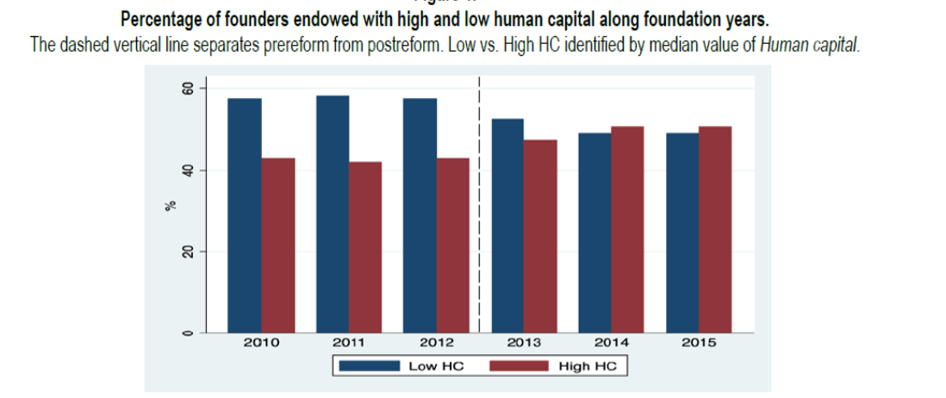
Italian Startup Act Evaluation
SBE, 2023
Vol. 60, pp. 707-728
Note that “For a new, high-technology firm, the primary assets are the knowledge and skills of the founders. Any competitive advantage the new firm achieves is likely to be based upon what the founders can do better than others” (Cooper and Bruno, 1977, Business Horizons, 20, p. 21)

Slide 20
Italian Startup Act Evaluation
SBE, 2022
Vol. 58, pp. 1699-1720

Slide 21
Please (if you wish) have a look at the POK (launched as joint collaboration POLIMI-UNCTAD United Nations in 2019)
EEP101 - Designing and Implementing Effective Entrepreneurship Policies: https://www.pok.polimi.it/course/view.php?id=140#tab2
The course revolves around three aims:
Describe the main rationales for policy interventions in the innovation/ entrepreneurship domain (something you have been through in these slides).
Analyse the characteristics of the vast array of policy measures implementable to sustain innovation/entrepreneurship in different countries (see our taxonomy).
Explain the importance of performing monitoring and evaluation analyses of entrepreneurship policies in the related context and the main associated challenges (this topic could be important, even beyond policy evaluation, since techniques are applicable irrespective of a specific domain) .
You can access the course absolutely free of charge and completely online (but it is no mandatory at any level for BIE).

Slide 22
References
Edler & Fagerberg, 2017, Innovation policy: what, why, and how, Oxford Review of Economic Policy, vol. 33 (1), pp. 2-23.
Hall, B. H. (2002). The financing of research and development. Oxford Review of Economic Policy, 18(1), 35-51.
Peneder, M. 2008. The problem of private under-investment in innovation: A policy mind map. Technovation, 28(8), 518-530.
Further reading:
Alemany, L., Andreoli, J.J. 2018. Entrepreneurial Finance, Ch. 4, Cambridge University Press.
Cohen, W. M., & Levinthal, D. A. (1990). Absorptive capacity: A new perspective on learning and innovation. Administrative Science Quarterly, 35(1), 128-152.
Grilli, L. 2014. High-Tech Entrepreneurship in Europe: A Heuristic Firm Growth Model and Three “(Un-)easy Pieces” for Policy-Making. Industry and Innovation, 21(4), 267-284.
Howell S. 2024. Government intervention in innovation. Annu. Rev. Financ. Econ. 16. In press. https://doi.org/10.1146/annurev-financial-082123-105722
Klette, T. J., Møen, J., & Griliches, Z. (2000). Do subsidies to commercial R&D reduce market failures? Microeconometric evaluation studies. Research Policy, 29(4-5), 471-495.
Parker, S.C. 2009. Principles of entrepreneurship policy. In Parker S.C. The Economics of Entrepreneurship. Cambridge University Press, chapter 15.
Teece, D. J. (1986). Profiting from technological innovation: Implications for integration, collaboration, licensing and public policy. Research Policy, 15(6), 285-305.

